Slide 1


Eduardo J. Ramos C.
December 2022

Slide 2

Outline
Executive Summary
Introduction
Methodology
Results
Conclusion
Appendix

Slide 3
Executive Summary
Summary of methodologies
Data collection
Data wrangling
Exploratory Data Analysis with Data Visualization
Exploratory Data Analysis with SQL
Building an interactive map with Folium
Building a Dashboard with Plotly Dash
Predictive analysis (Classification)
Summary of all results
Exploratory Data Analysis results
Interactive analytics demo in screenshots
Predictive analysis results

Slide 4
Introduction
Project background and context
Space X advertises Falcon 9 rocket launches on its website with a cost of 62 million dollars; other providers cost upward of 165 million dollars each, much of the savings is because Space X can reuse the first stage. Therefore if we can determine if the first stage will land, we can determine the cost of a launch. This information can be used if an alternate company wants to bid against space X for a rocket launch.
Problems you want to find answers
How do variables such as payload mass, launch site, number of flights, and orbits affect the success of the first stage landing?
Does the rate of successful landings increase over the years?
What is the best algorithm that can be used for binary classification in this case?

Slide 5

Section 1

Slide 6
Methodology
Executive Summary
Data collection methodology:
Perform data wrangling
Perform exploratory data analysis (EDA) using visualization and SQL
Perform interactive visual analytics using Folium and Plotly Dash
Perform predictive analysis using classification models
Via SpaceX Rest API | Web Scrapping from Wikipedia
Filtering the data | Dealing with missing values
Using One Hot Encoding to prepare the data to a binary classification
Building, tuning and evaluation of classification models to ensure the best results

Slide 7

Data Collection
Data collection is a process of grouping data from different sources and media in order to filter and obtain information that can be analyzed.
Data Columns are obtained by using SpaceX REST API: FlightNumber, Date, BoosterVersion, PayloadMass, Orbit, LaunchSite, Outcome, Flights, GridFins, Reused, Legs, LandingPad, Block, ReusedCount, Serial, Longitude, Latitude
Data Columns are obtained by using Wikipedia Web Scraping: Flight No., Launch site, Payload, PayloadMass, Orbit, Customer, Launch outcome, Version Booster, Booster landing, Date, Time
Step 1
Getting Data from API or Web Page
Step 2
Make a DataFrame
Step 3
Filter DataFrame
Step 4
Generate a CSV file

Slide 8
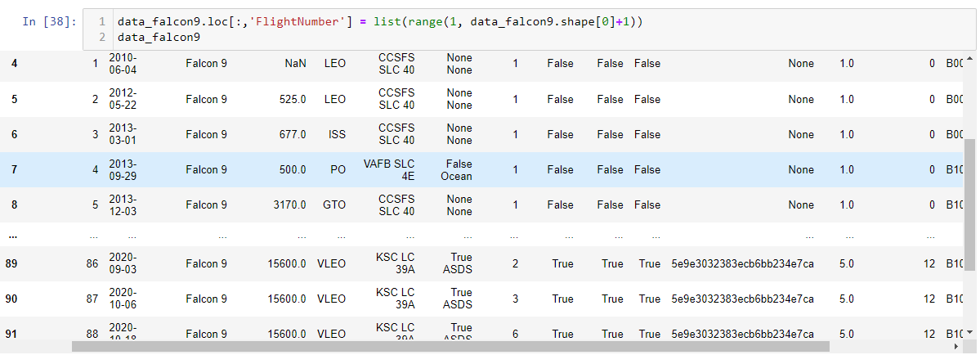
Data Collection – SpaceX API
Requesting
rocket launch
data from
SpaceX API
Decoding the
response content
using .json() and
turning it into a
dataframe using
.json_normalize()
Requesting needed
information about
the launches from
SpaceX API
by applying
custom functions
Filtering the
dataframe to only
include Falcon 9
launches
Constructing data
we have obtained
into a dictionary
Exporting the data
to CSV
Creating a dataframe
from the dictionary
GitHub URL

Slide 9
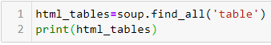
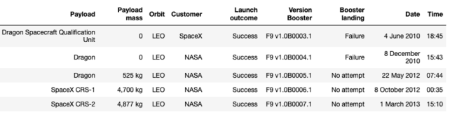
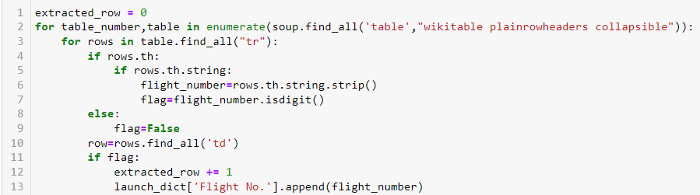
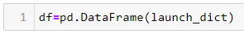
Data Collection - Scraping
Requesting
Falcon 9 launch
data from
Wikipedia
Creating a
BeautifulSoup object
from the HTML
response
Extracting
all column names
from the HTML table
header
Collecting the data
by parsing
HTML tables
Constructing data
we have obtained
into a dictionary
Creating a dataframe from the dictionary
Exporting the data to CSV
GitHub URL

Slide 10
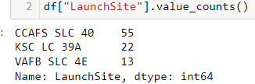
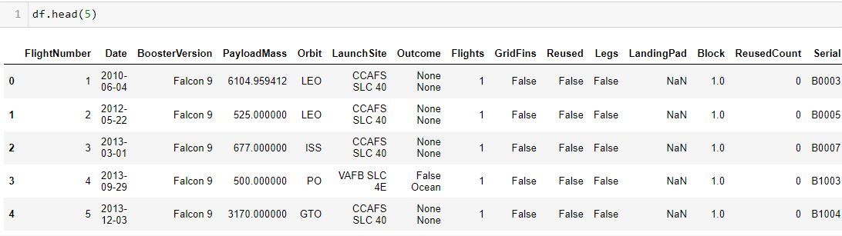
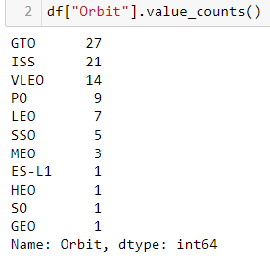
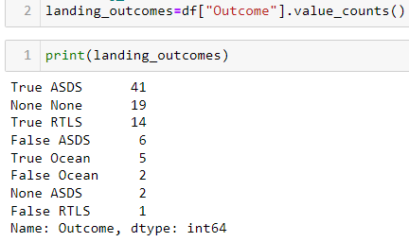
Data Wrangling
Calculate the number of
launches on each site
Create a landing outcome label
from Outcome column
Calculate the number and
occurrence of each orbit
Export dataset as .cvs
Calculate the number and occurrence
of mission outcome per orbit type
GitHub URL

Slide 11
EDA with Data Visualization
Line Plot
Line plots show trends in data over time (time series)
Success Rate Yearly Trend
Scatter Plots
Scatter plots show the relationship between variables. If a relationship exists,
they could be used in machine learning model
Flight Number vs. Payload Mass
Flight Number vs. Launch Site
Payload Mass vs. Launch Site
Orbit Type vs. Success Rate
Flight Number vs. Orbit Type
Bar Plot
Bar charts show comparisons among discrete categories. The goal is to show the relationship between the specific categories being compared and a measured value.
Payload Mass vs Orbit Type
GitHub URL

Slide 12
EDA with SQL
Performed SQL queries:
Names of the unique launch sites in the space mission
5 records where launch sites begin with the string 'CCA’.
The total payload mass carried by boosters launched by NASA (CRS).
Average payload mass carried by booster version F9 v1.1.
Date when the first succesful landing outcome in ground pad was acheived.
Names of the boosters which have success in drone ship and have payload mass greater than 4000 but less than 6000.
Total number of successful and failure mission outcomes.
Names of the booster_versions which have carried the maximum payload mass.
The records which will display the month names, failure landing_outcomes in drone ship ,booster versions, launch_site for the months in year 2015.
Rank the count of successful landing_outcomes between the date 04-06-2010 and 20-03-2017 in descending order.
GitHub URL

Slide 13
Build an Interactive Map with Folium
Markers of all Launch Sites:
Added Marker with Circle, Popup Label and Text Label of NASA Johnson Space Center using its latitude and longitude coordinates as a start location.
Added Markers with Circle, Popup Label and Text Label of all Launch Sites using their latitude and longitude coordinates to show their geographical locations and proximity to Equator and coasts.
Coloured Markers of the launch outcomes for each Launch Site:
Added coloured Markers of success (Green) and failed (Red) launches using Marker Cluster to identify which launch sites have relatively high success rates.
Distances between a Launch Site to its proximities:
Added coloured Lines to show distances between the Launch Site KSC LC-39A (as an example) and its proximities like Railway, Highway, Coastline and Closest City.
GitHub URL

Slide 14
Build a Dashboard with Plotly Dash
Launch Sites Dropdown List:
Added a dropdown list to enable Launch Site selection.
Pie Chart showing Success Launches (All Sites/Certain Site):
Added a pie chart to show the total successful launches count for all sites and the
Success vs. Failed counts for the site, if a specific Launch Site was selected.
Slider of Payload Mass Range:
- Added a slider to select Payload range.
Scatter Chart of Payload Mass vs. Success Rate for the diﬀerent Booster Versions:
- Added a scatter chart to show the correlation between Payload and Launch Success.
GitHub URL

Slide 15
Predictive Analysis (Classification)
Creating a NumPy array from the column “Class” in data
Creating a GridSearchCV object with cv = 10 to find the best parameters
Applying GridSearchCV on LogReg, SVM, Decision Tree, and KNN models
Calculating the accuracy on the test data using the method .score() for all models
Examining the confusion matrix for all models
Finding the method performs best by examining the Jaccard_score and F1_score metrics
Standardizing the data with StandardScaler, then fitting and transforming it
Splitting the data into training and testing sets with train_test_split function
GitHub URL

Slide 16
Results
Exploratory data analysis results
Interactive analytics demo in screenshots
Predictive analysis results

Slide 17

Section 2

Slide 18
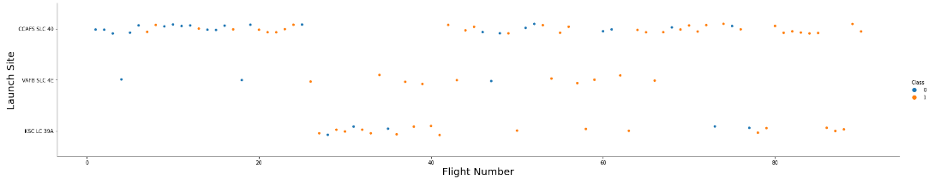
Flight Number vs. Launch Site
Explanation:
• The earliest flights all failed while the latest flights all succeeded.
• The CCAFS SLC 40 launch site has about a half of all launches.
• VAFB SLC 4E and KSC LC 39A have higher success rates.
• It can be assumed that each new launch has a higher rate of success.

Slide 19
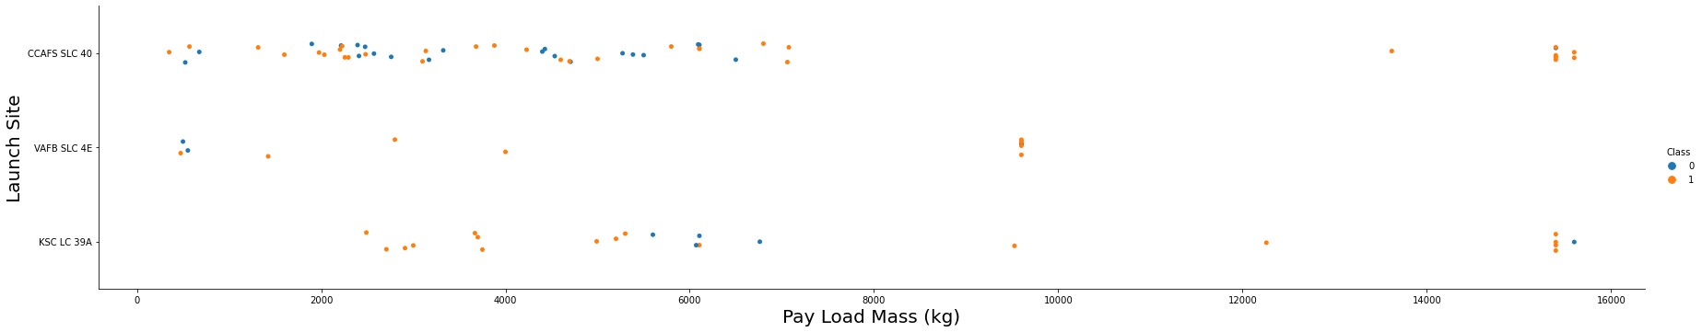
Payload vs. Launch Site
Explanation:
• For every launch site the higher the payload mass, the higher the success rate.
• Most of the launches with payload mass over 7000 kg were successful.
• KSC LC 39A has a 100% success rate for payload mass under 5500 kg too.

Slide 20
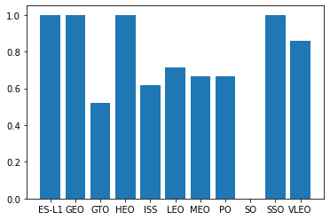
Success Rate vs. Orbit Type
Explanation:
• Orbits with 100% success rate:
- ES-L1, GEO, HEO, SSO
• Orbits with 0% success rate:
- SO
• Orbits with success rate between 50% and 85%:
- GTO, ISS, LEO, MEO, PO

Slide 21
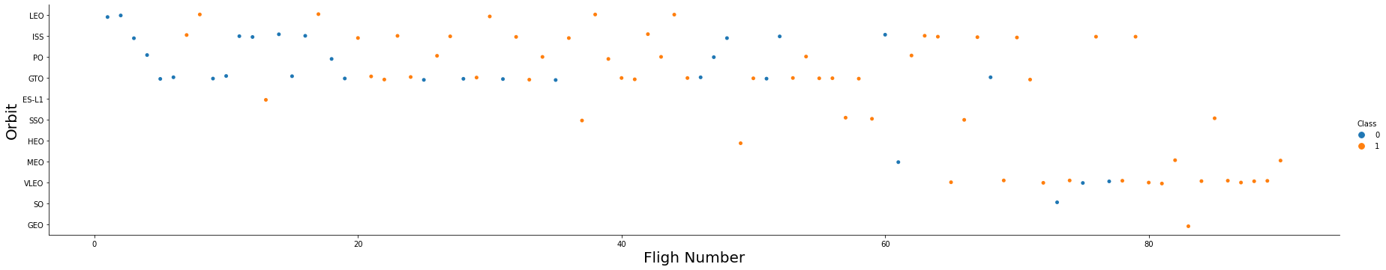
Flight Number vs. Orbit Type
Explanation:
In the LEO orbit the Success appears related to the number of flights; on the other hand, there seems to be no relationship between flight number when in GTO orbit.

Slide 22
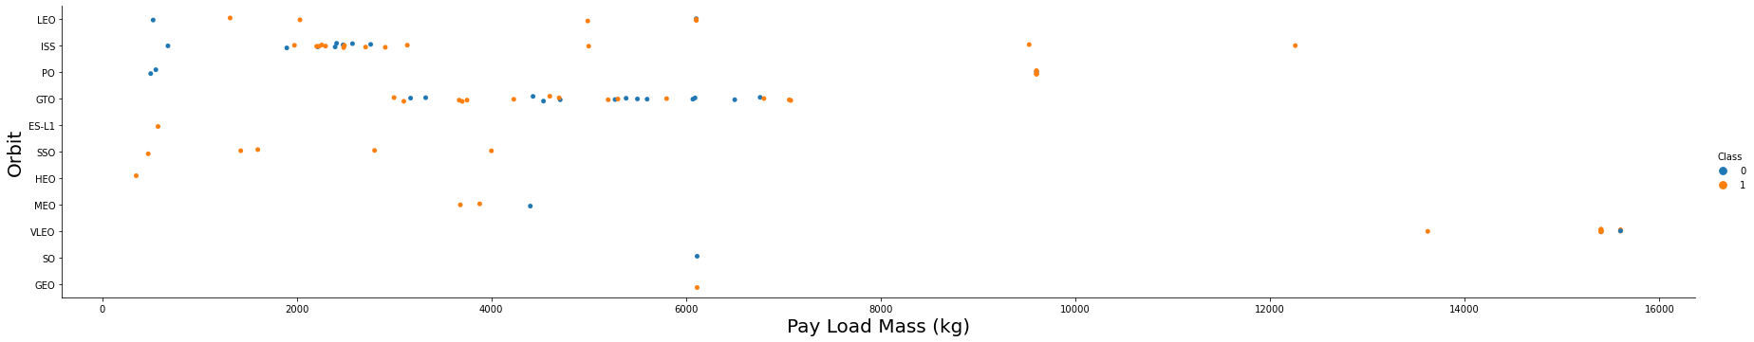
Payload vs. Orbit Type
Explanation:
Heavy payloads have a negative influence on GTO orbits and positive on GTO and Polar LEO (ISS) orbits.

Slide 23
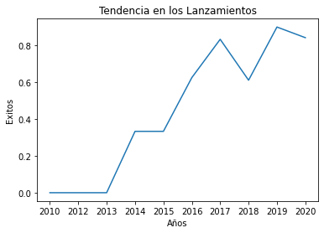
Launch Success Yearly Trend
Explanation:
• The success rate since 2013 kept increasing till 2020.

Slide 24
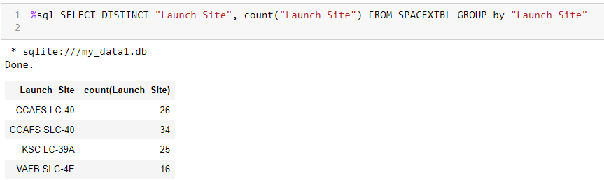
All Launch Site Names
Explanation:
• Displaying the names of the unique launch sites in the space mission.

Slide 25
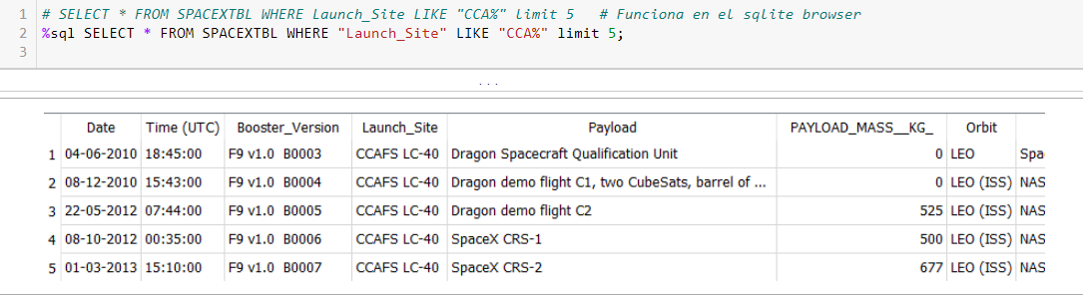
Launch Site Names Begin with 'CCA'
Explanation:
• Displaying 5 records where launch sites begin with the string 'CCA'.

Slide 26
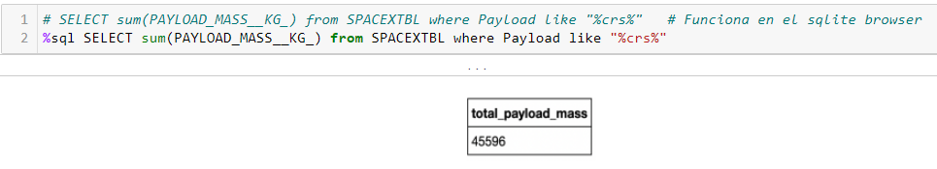
Total Payload Mass
Explanation:
• Displaying the total payload mass carried by boosters launched by NASA (CRS).

Slide 27
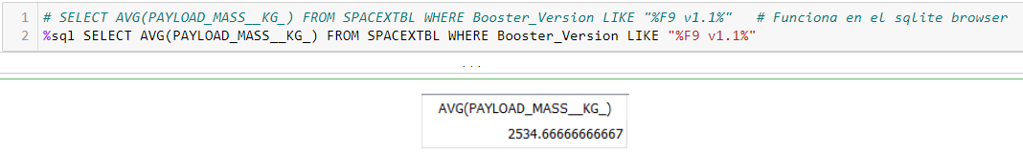
Average Payload Mass by F9 v1.1
Explanation:
• Displaying average payload mass carried by booster version F9 v1.1.

Slide 28
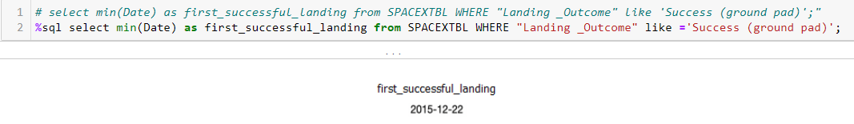
First Successful Ground Landing Date
Explanation:
• Listing the date when the first successful landing outcome in ground pad was achieved.

Slide 29
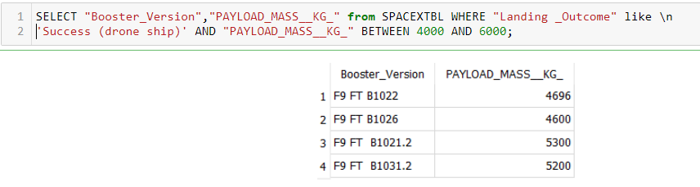
Successful Drone Ship Landing with Payload between 4000 and 6000
Explanation:
Listing the names of the boosters which have success in drone ship and have payload mass greater than 4000 but less than 6000.

Slide 30
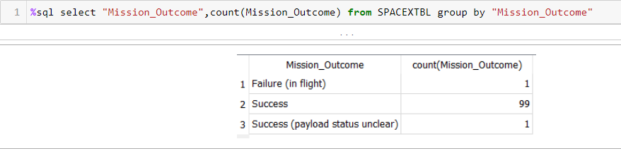
Total Number of Successful and Failure Mission Outcomes
Explanation:
Listing the total number of successful and failure mission outcomes.

Slide 31
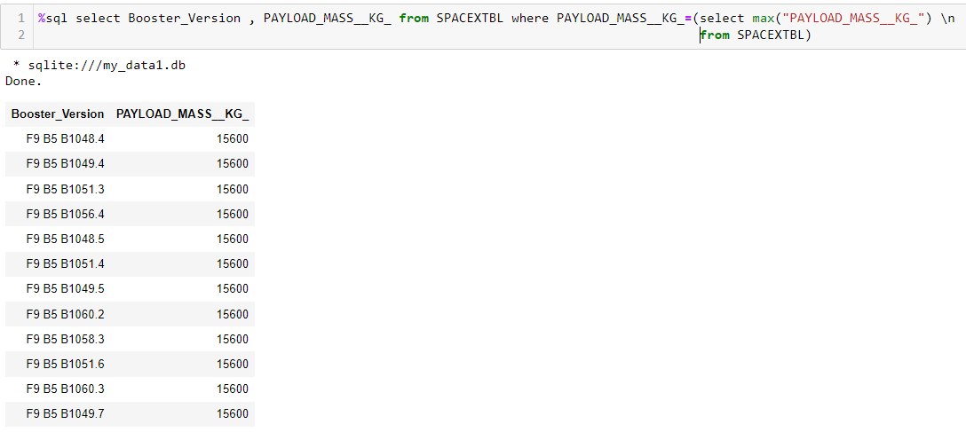
Boosters Carried Maximum Payload
Explanation:
Listing the names of the booster versions which have carried the maximum payload mass.

Slide 32
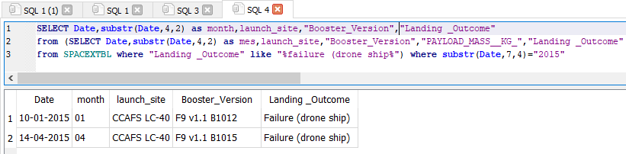
2015 Launch Records
Explanation:
Listing the failed landing outcomes in drone ship, their booster versions and launch site names for the months in year 2015.

Slide 33
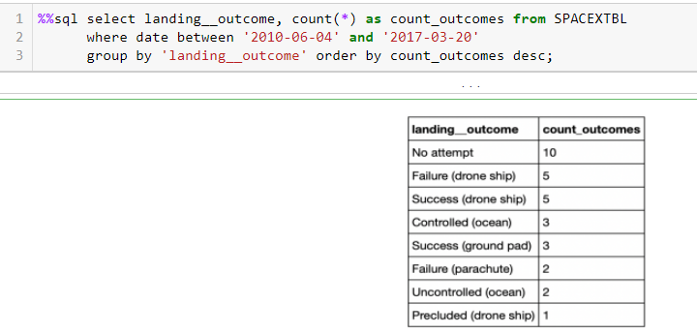
Rank Landing Outcomes Between 2010-06-04 and 2017-03-20
Explanation:
Ranking the count of landing outcomes (such as Failure (drone ship) or Success (ground pad)) between the date 2010-06-04 and 2017-03-20 in descending order.

Slide 34

Section 3

Slide 35
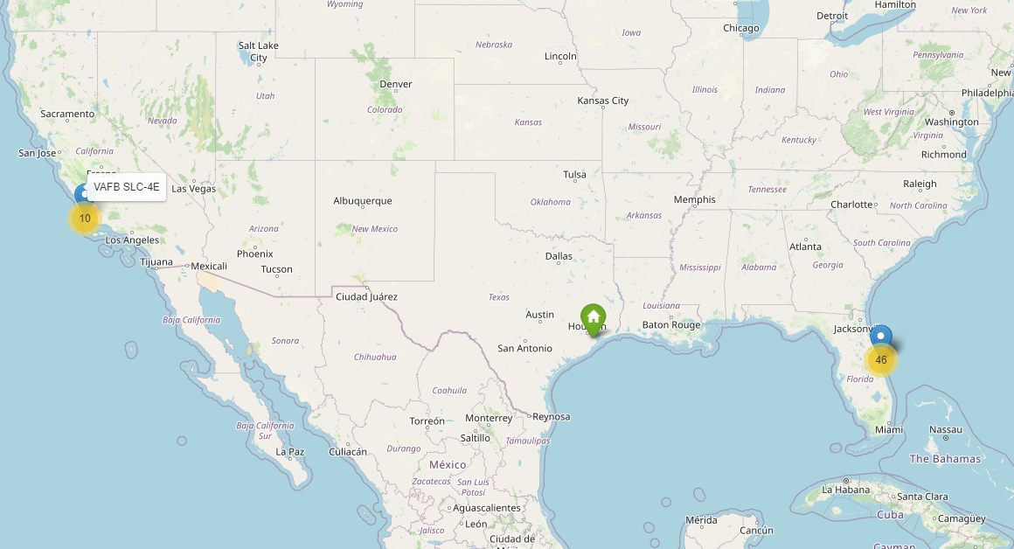
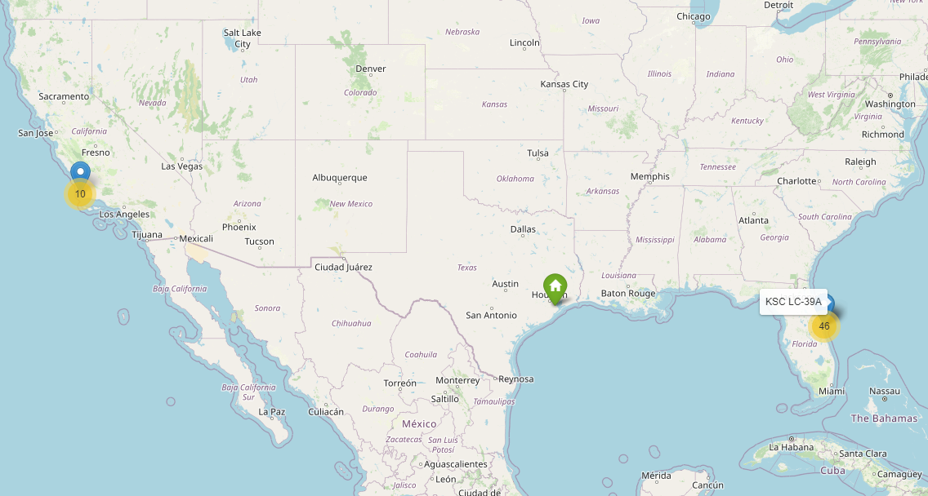
All Launch Sites on Folium Map
The ideal launch sites are near the equator and near coastlines. As can be seen on the map, the three launch sites are as far south as the US geography allows and very close to its coasts.

Slide 36
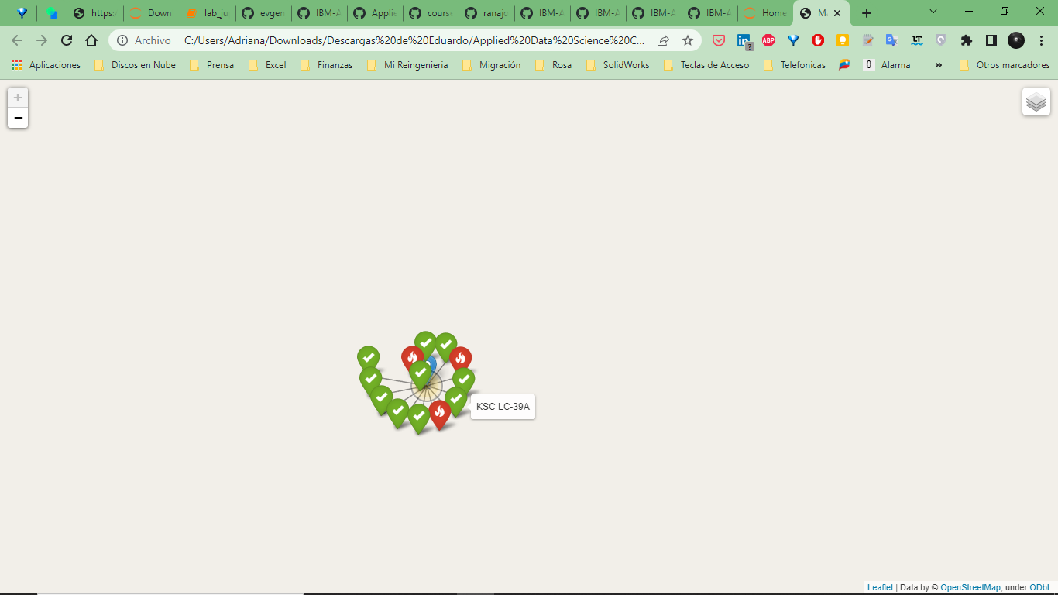
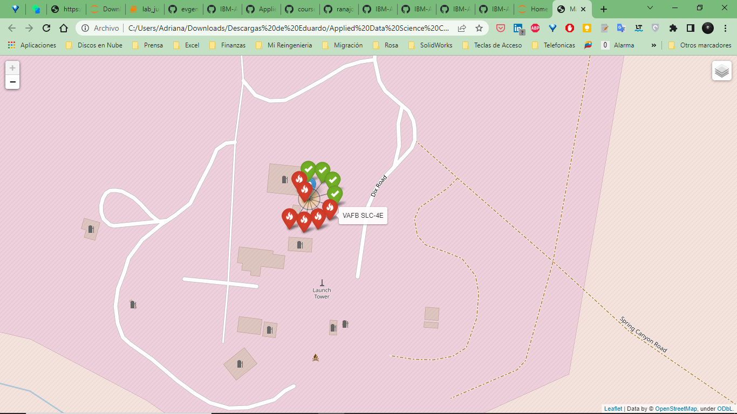
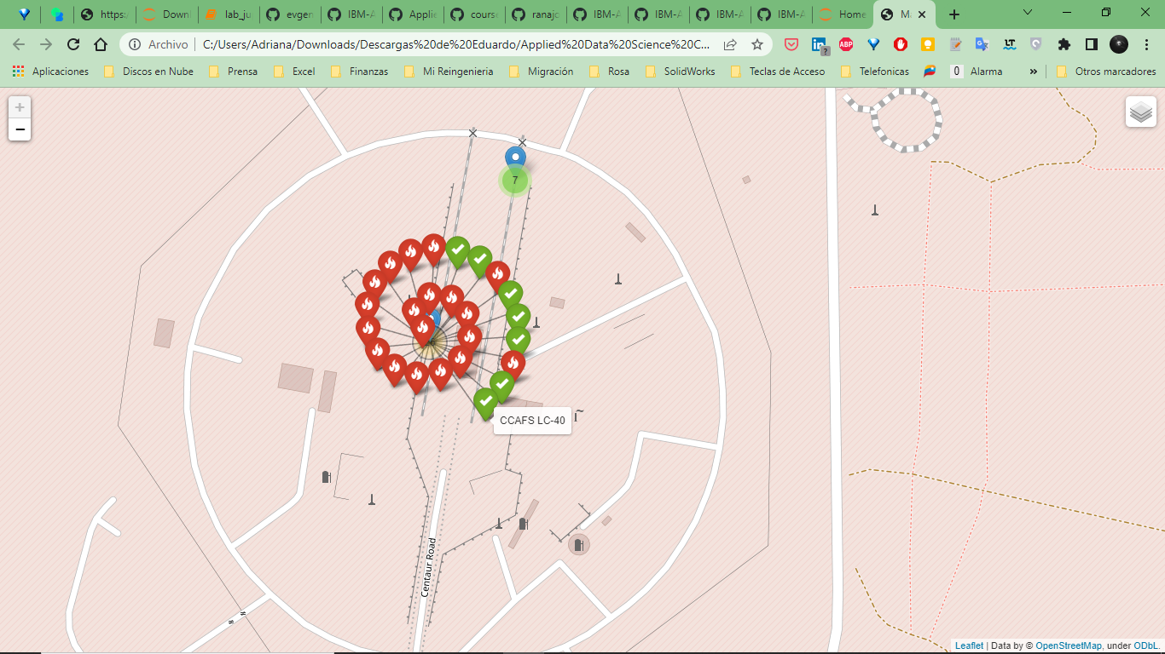
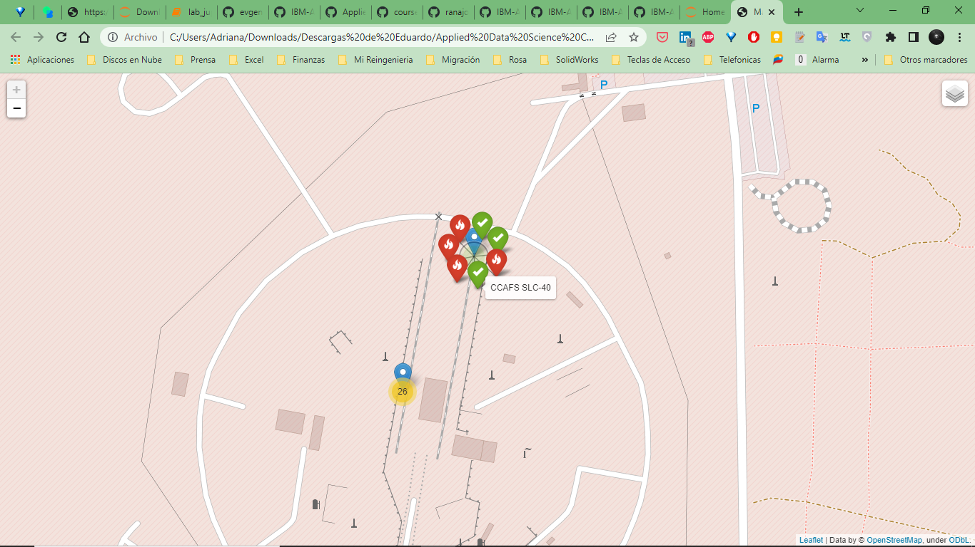
All launch sites’ location markers
Green Marker shows successful launches and Red Marker shows failures.
From these screenshots its easily understandable that KSC LC-39A has the maximum probability of success

Slide 37
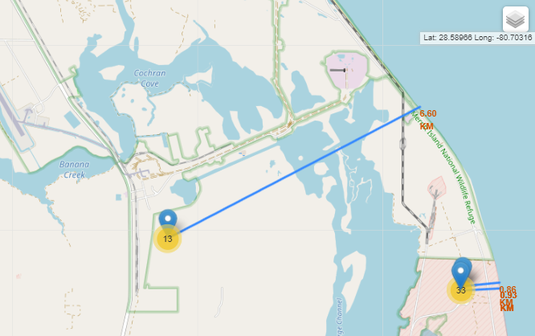
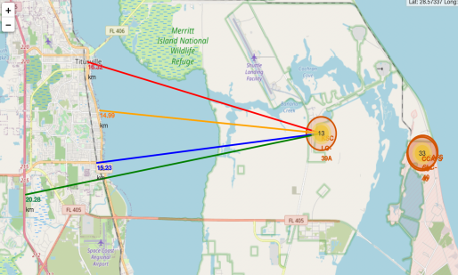
Distance from the launch site KSC LC-39A to its proximities
Are launch sites in close proximity to railways?
Yes, distance < 2 Km
Are launch sites in close proximity to highways?
No, distance < 15 km
Are launch sites in close proximity to coastline?
Yes, distance < 5 Km
Do launch sites keep certain distance away from cities?
Yes, distance > 15 km

Slide 38

Section 4

Slide 39
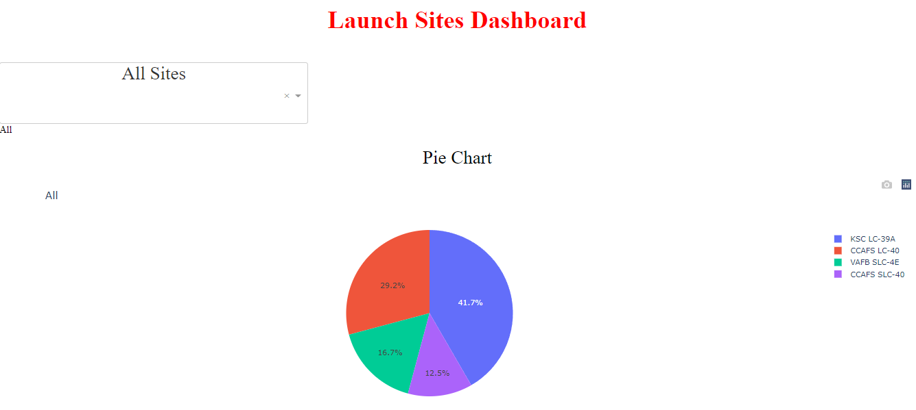
Launch Sites Dashboard
Explanation:
• The chart clearly shows that from all the sites, KSC LC-39A has the most successful launches.

Slide 40
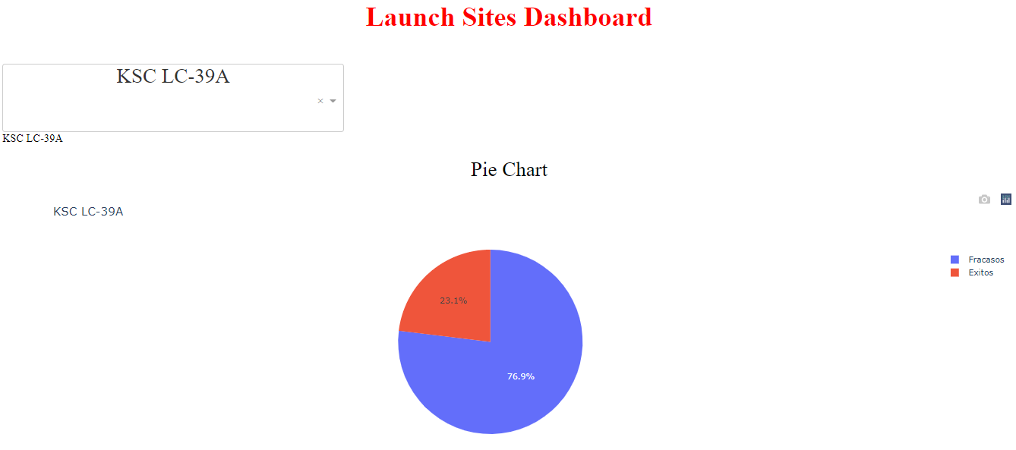
Launch site with highest launch success ratio
Explanation:
• KSC LC-39A has the highest launch success rate (76.9%) with 10 successful and only 3 failed landings.

Slide 41
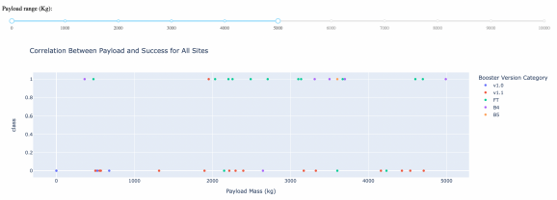
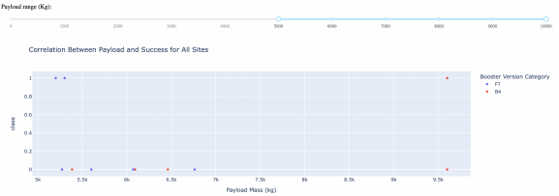
Payload Mass vs. Launch Outcome for all sites
Explanation:
• The charts show that payloads between 2000 and 5500 kg have the highest success rate.

Slide 42

Section 5

Slide 43
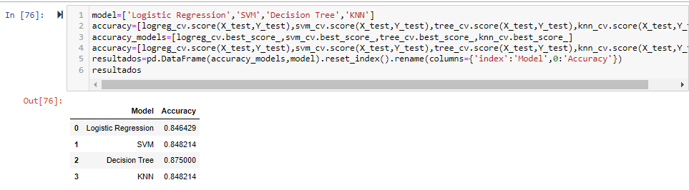
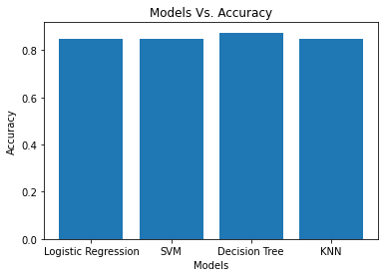
Classification Accuracy
Explanation:
The scores of the whole Dataset confirm that the best model is the Decision Tree Model. This model has not only higher scores, but also the highest accuracy.

Slide 44
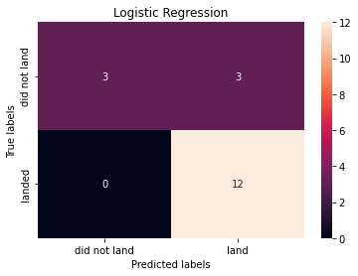
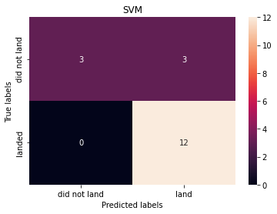


Confusion Matrix
Explanation:
Examining the confusion matrix, we see that Decision Tree can distinguish between the different classes.

Slide 45
Conclusions
Decision Tree Model is the best algorithm for this dataset.
Launches with a low payload mass show better results than launches with a larger payload mass.
KSC LC-39A has the highest success rate of the launches from all the sites.
Most of launch sites are in proximity to the Equator line and all the sites are in very close proximity to the coast.
The success rate of launches increases over the years.
Orbits ES-L1, GEO, HEO and SSO have 100% success rate.

Slide 46
Appendix
Include any relevant assets like Python code snippets, SQL queries, charts, Notebook outputs, or data sets that you may have created during this project

Slide 47


